Slide 1



Slide 2

Demo of a
Simple Bixby Capsule :
Movies Capsule

Slide 3
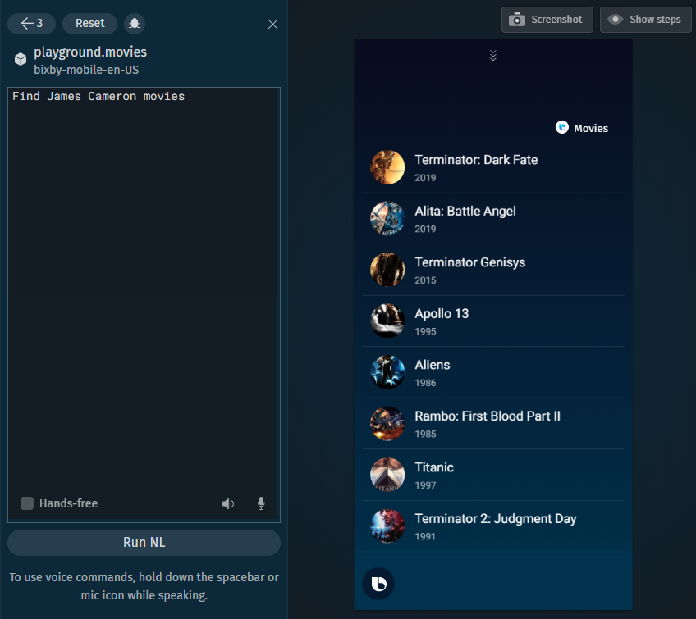
Type 1 Queries:
If the query contains some name of the person, then the movies are discovered in which the person was involved.
Involvement can be in any way – the person can be an actor, a director, a producer or any other role in which that person has contributed.
Note: Sometimes this capsule provides wrong results, but that is just because of inaccurate data provided by the API.

Slide 4
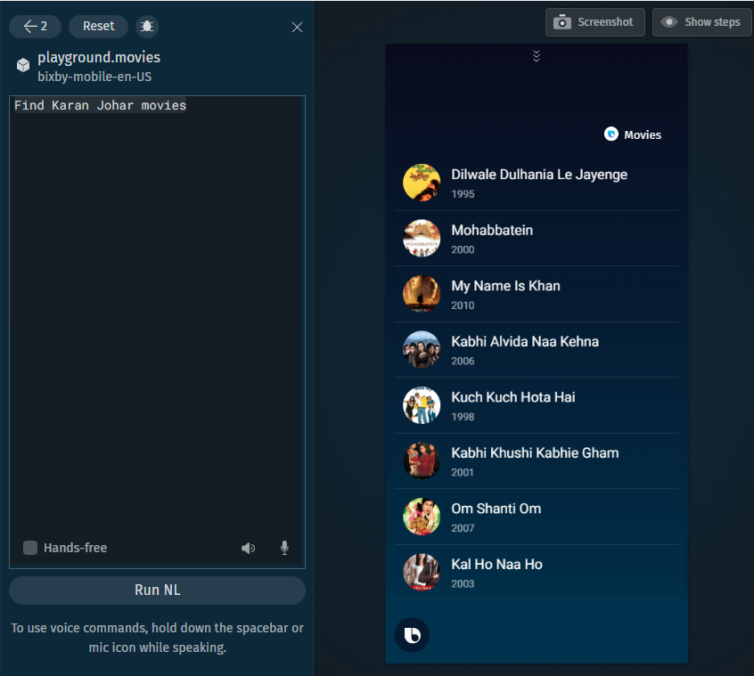
More Examples of Type 1 Queries:
Example 1 – Search by the name of Director.
Note: The database is regionally generic. Hence, the director can be an Indian director, a Spanish director, or any other director from almost any region of the world.

Slide 5
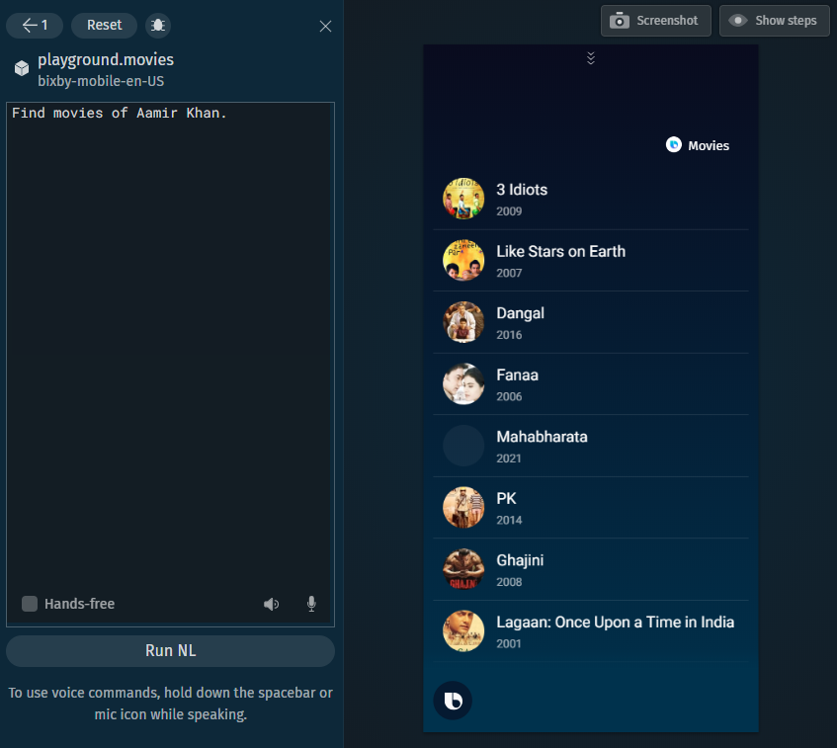
More Examples of Type 1 Queries:
Example 1 – Search by the name of an Actor.
Note: The term actor is generic here. This means – it could be the name of an actress as well. Also, the capsule doesn’t assume that the actor is the lead actor. Even the name of supporting cast is sufficient for the search.

Slide 6
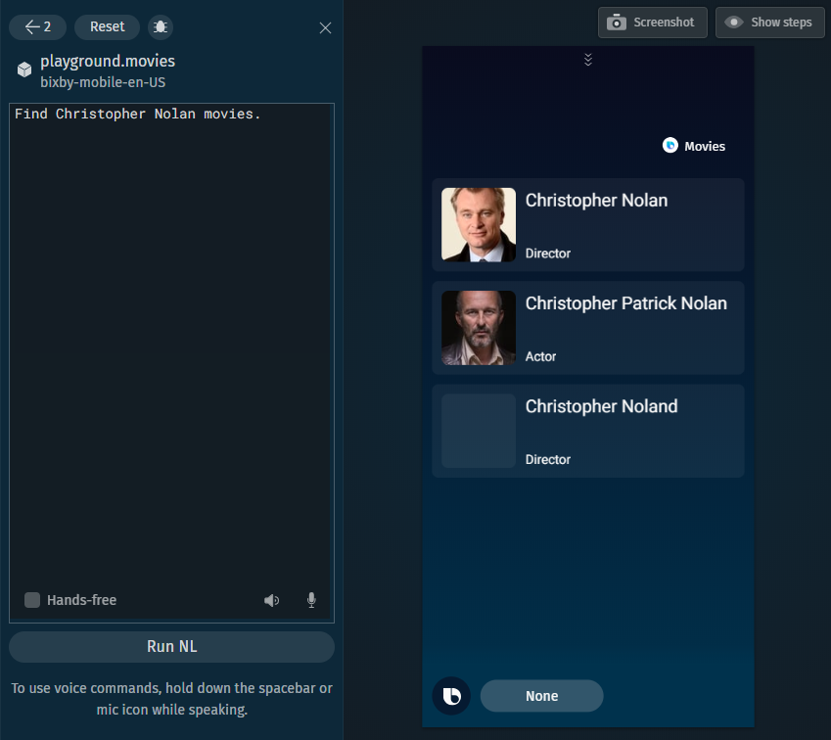
Type 2 Queries:
If there is some ambiguity in the name of the person, capsule suggests/prompts the user to select the desired person.
A small ‘conversational driver’ of None as an option is also included.
Note: This may also occur due to repetition of names of the same person in the database.

Slide 7
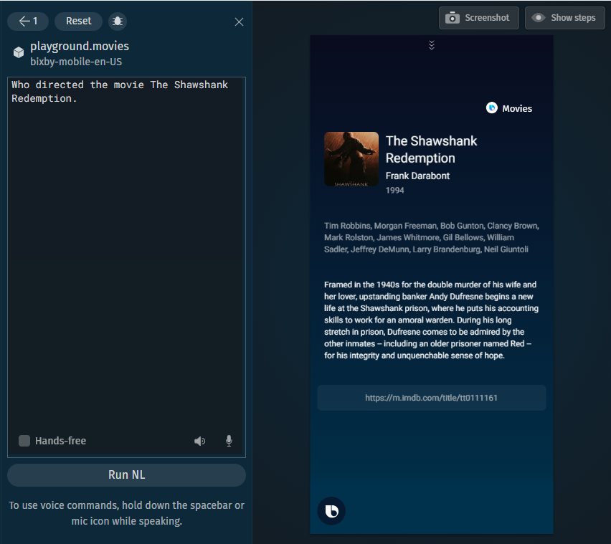
Type 3 Queries:
These are the queries which directly target some particular movie.
These queries are more flexible as one can target movies by making a lot of natural language utterances.
An IMDB link is provided in the movie description. If that link is clicked, that link opens up in the mobile phone’s browser.

Slide 8
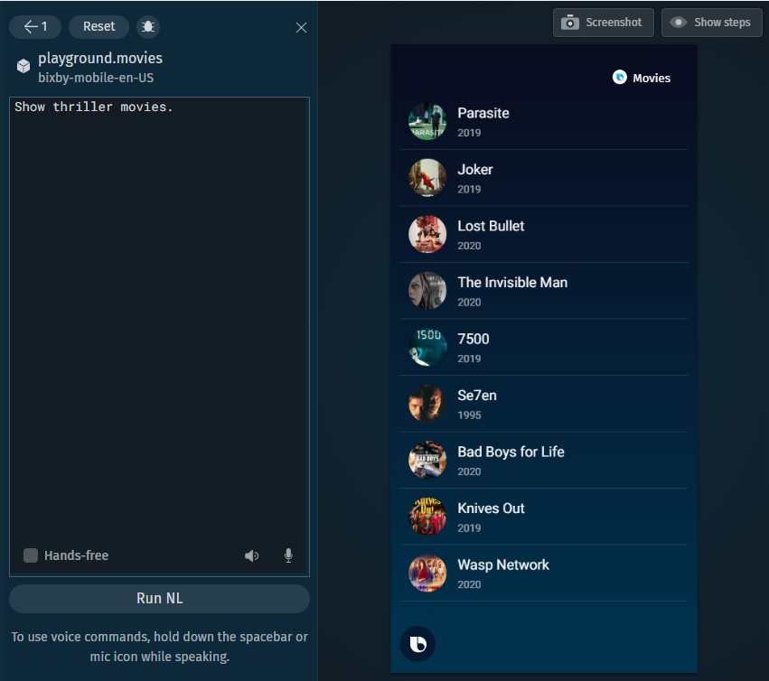
Type 4 Queries:
These are the queries based on genre.
Note: The ‘genre-based’ search usually provided a very poor performance. One may encounter some suspense or thriller-based movies, under the genre of comedy.
Hence, the implementation of Type 4 Queries isn’t promoted.

Slide 9
How to make such
a Bixby Capsule ?
Let’s go through the Capsule Development Process
considering ‘Movies Capsule’ as an example!

